Slide 1
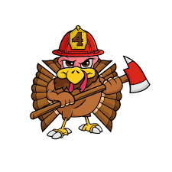
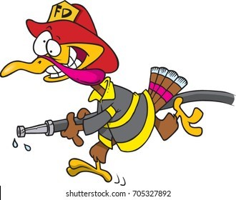
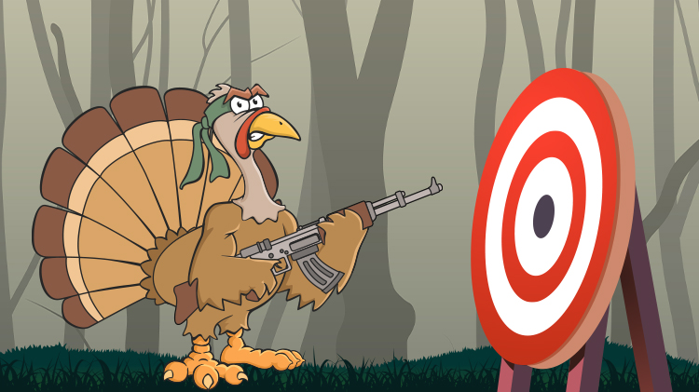
ELEVATION FIREFIGHTER’S ASSOCIATION TURKEY SHOOT
November 8th , 9th , 15th , 16th , 22nd , 23nd , and 27th Starting at 7pm

Slide 2
ELEVATION FIREFIGHTER’S ASSOCIATION TURKEY SHOOT
GUN RAFFLE DRAWING
RETAY GORDION MOSSY OAK NEW BOTTOMLAND 12ga
3” Chamber – 28” Barrel
$20.00 Per Ticket
RAFFLE RUNS FROM THE 8TH NOVEMBER THROUGH 27TH OF NOVEMBER
Drawing will be held live on the 27th of November at 9pm you don’t need to be present to win

Slide 3
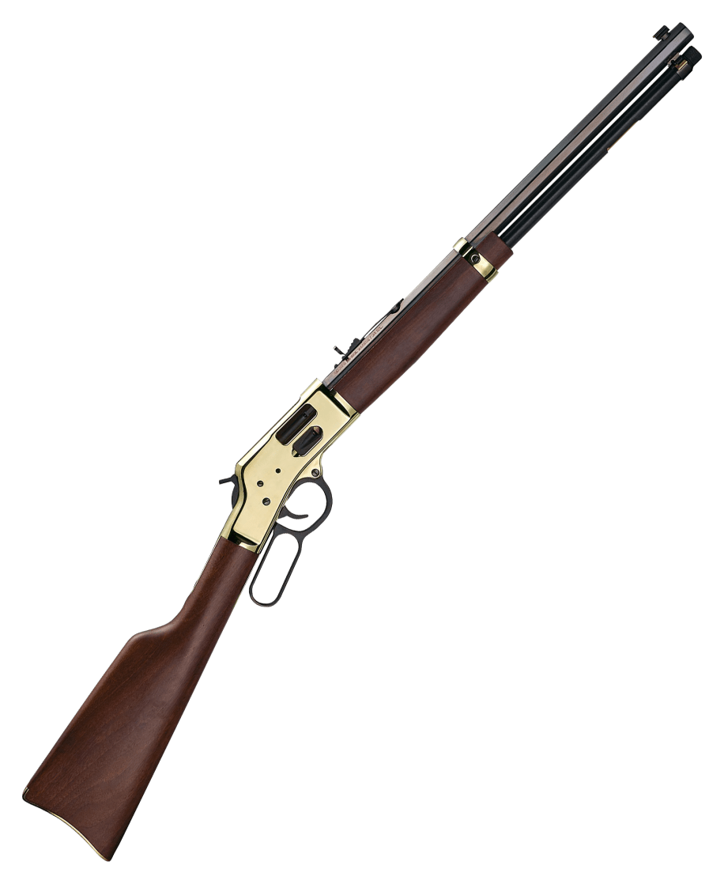
ELEVATION FIREFIGHTER’S ASSOCIATION TURKEY SHOOT
RIFLE RAFFLE DRAWING
Henry Golden Boy HO 24 Brass Side Gate Lever Action Rifle
$20.00 Per Ticket
RAFFLE RUNS FROM THE 8TH NOVEMBER THROUGH 27TH OF NOVEMBER
Drawing will be held live on the 27th of November at 9pm you don’t need to be present to win

Slide 4
ELEVATION FIREFIGHTER’S ASSOCIATION TURKEY SHOOT
50/50 RAFFLE
TICKETS ARE $10 EACH CAN BE PURCHASED FROM A FIREFIGHTER, AT THE FD, DURING THE TURKEY SHOOT OR ONLINE.
EVERY SATURDAY A DRAWING WILL BE HELD TO WIN $100 OR 10 FREE TICKETS TO BE ENTERED INTO THE 50/50 RAFFLE ON THE 27TH OF NOVEMBER

Slide 5
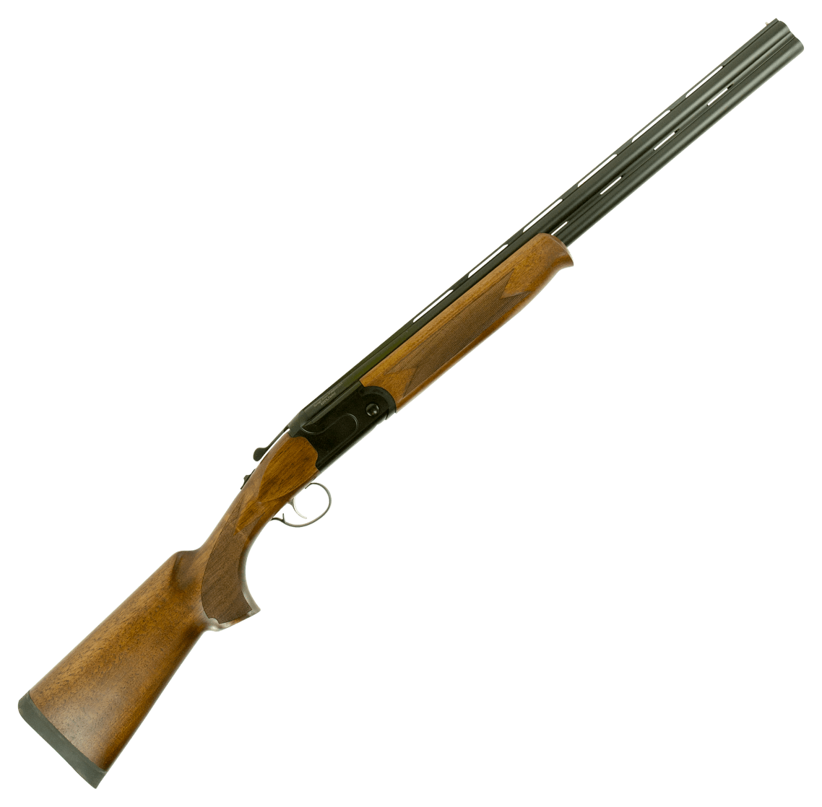
ELEVATION FIREFIGHTER’S ASSOCIATION TURKEY SHOOT
GUN BOARD
Stevens-555 Over/Under Shotgun
$50 Per Card

Slide 6
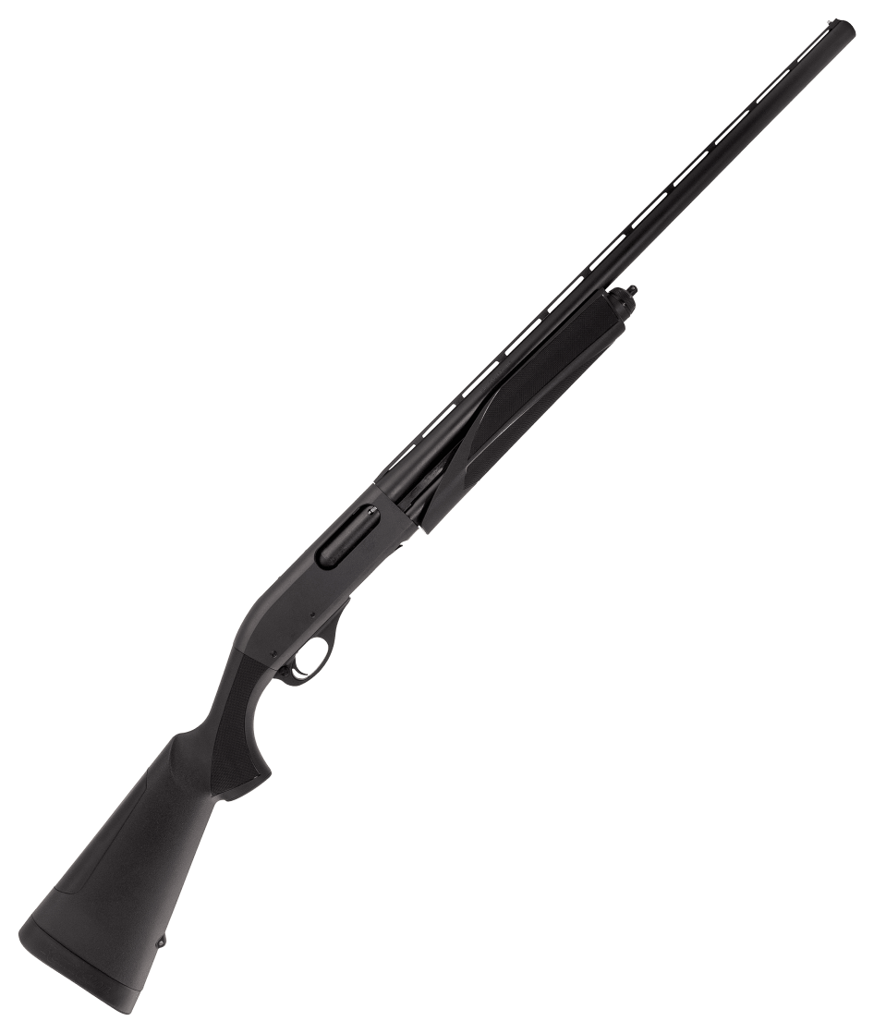
ELEVATION FIREFIGHTER’S ASSOCIATION TURKEY SHOOT
GUN BOARD
Remington 870 Fieldmaster
$40 Per Card

Slide 7
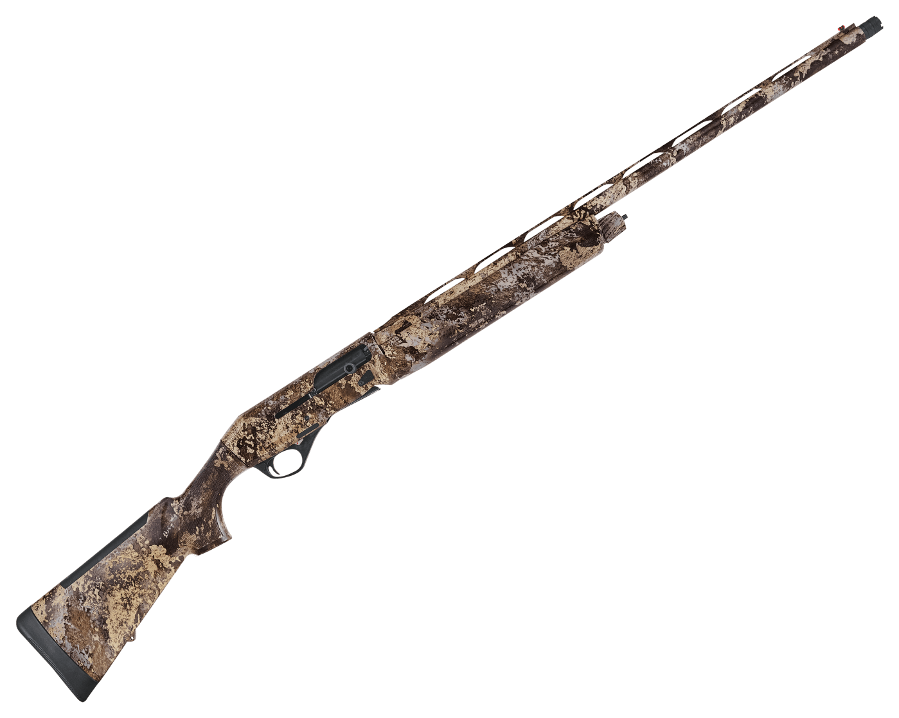
ELEVATION FIREFIGHTER’S ASSOCIATION TURKEY SHOOT
GUN BOARD
Stoeger M3000 Semi-Auto Shotgun
$40 Per Card

Slide 8
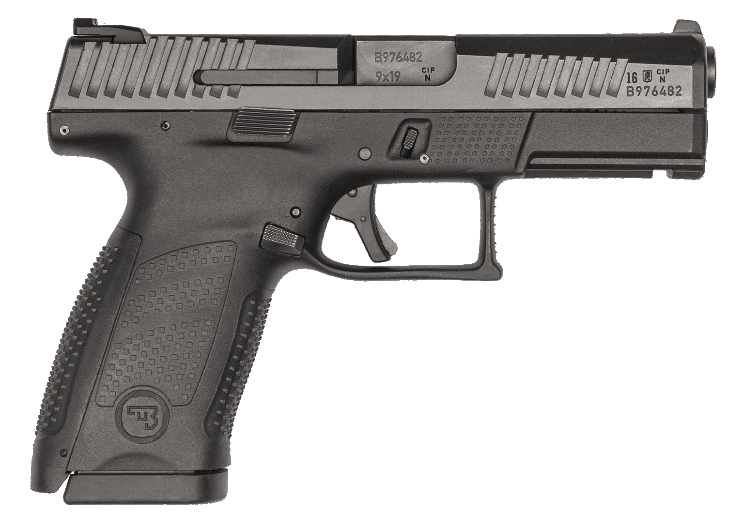
ELEVATION FIREFIGHTER’S ASSOCIATION TURKEY SHOOT
GUN BOARD
CZ USA P-10 Semi-Auto Pistol
$40 Per Card

Slide 9
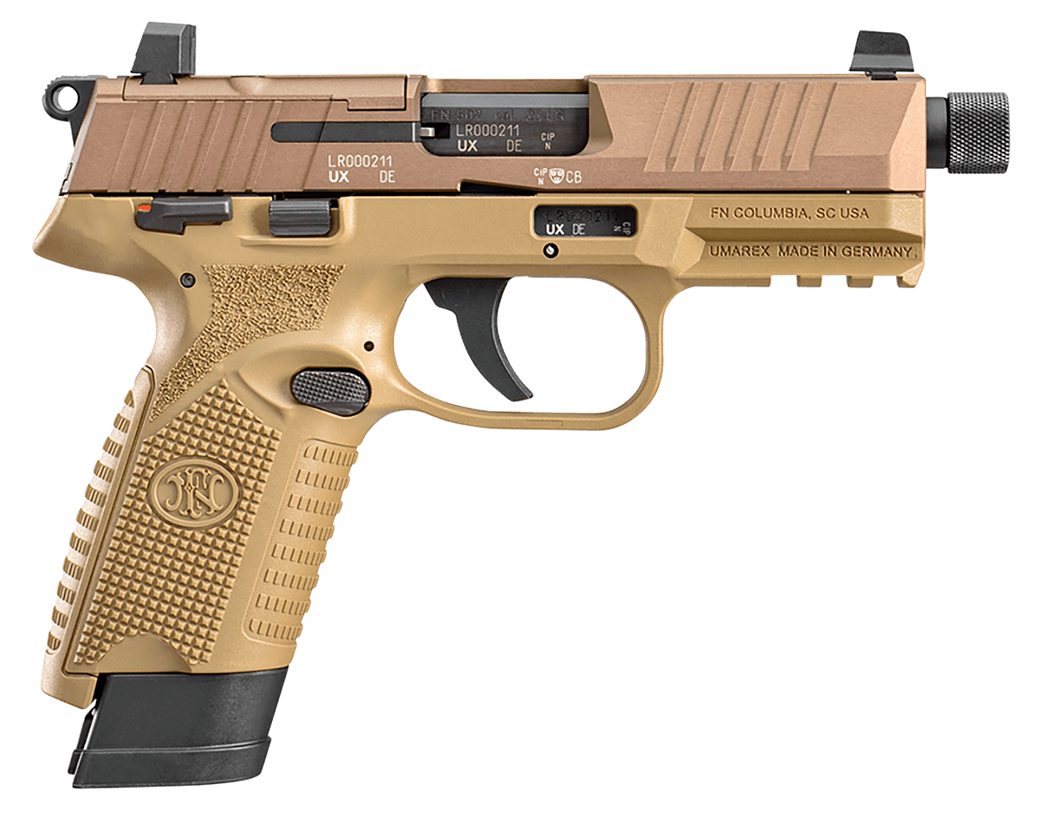
ELEVATION FIREFIGHTER’S ASSOCIATION TURKEY SHOOT
GUN BOARD
FN 502 Tactical Optics Semi-Auto Pistol
$30 Per Card

Slide 10
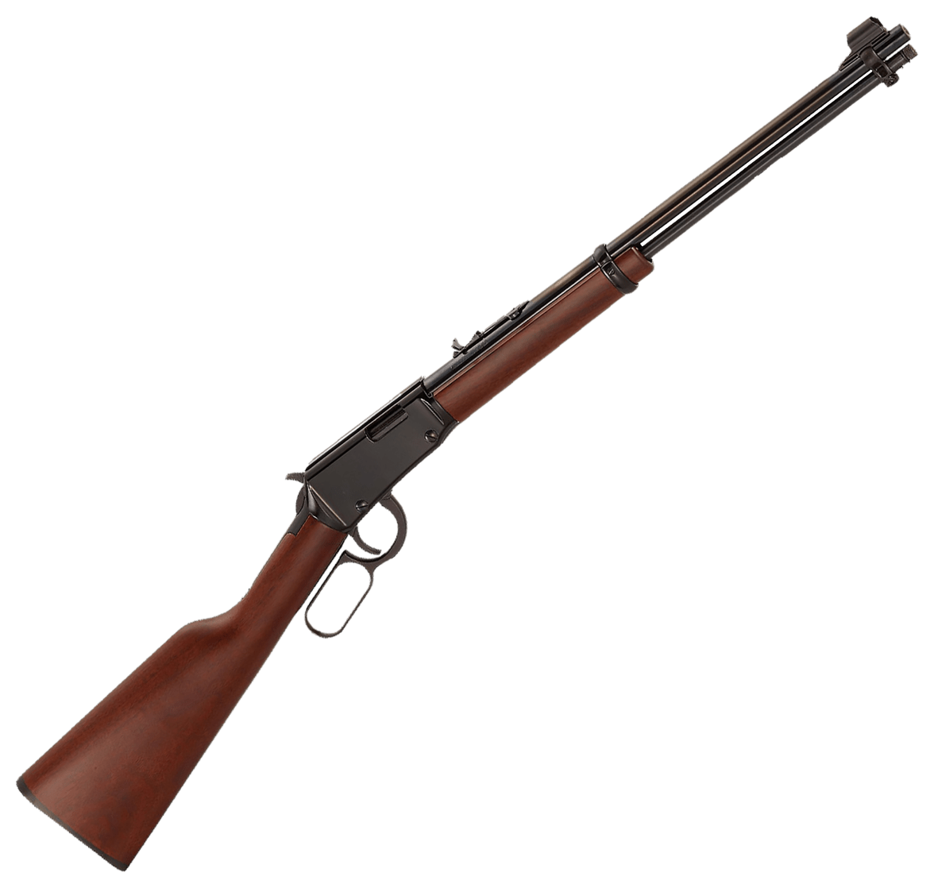
ELEVATION FIREFIGHTER’S ASSOCIATION TURKEY SHOOT
GUN BOARD
Henry Classic Lever Action .22 Long Rifle
$30 Per Card

Slide 11
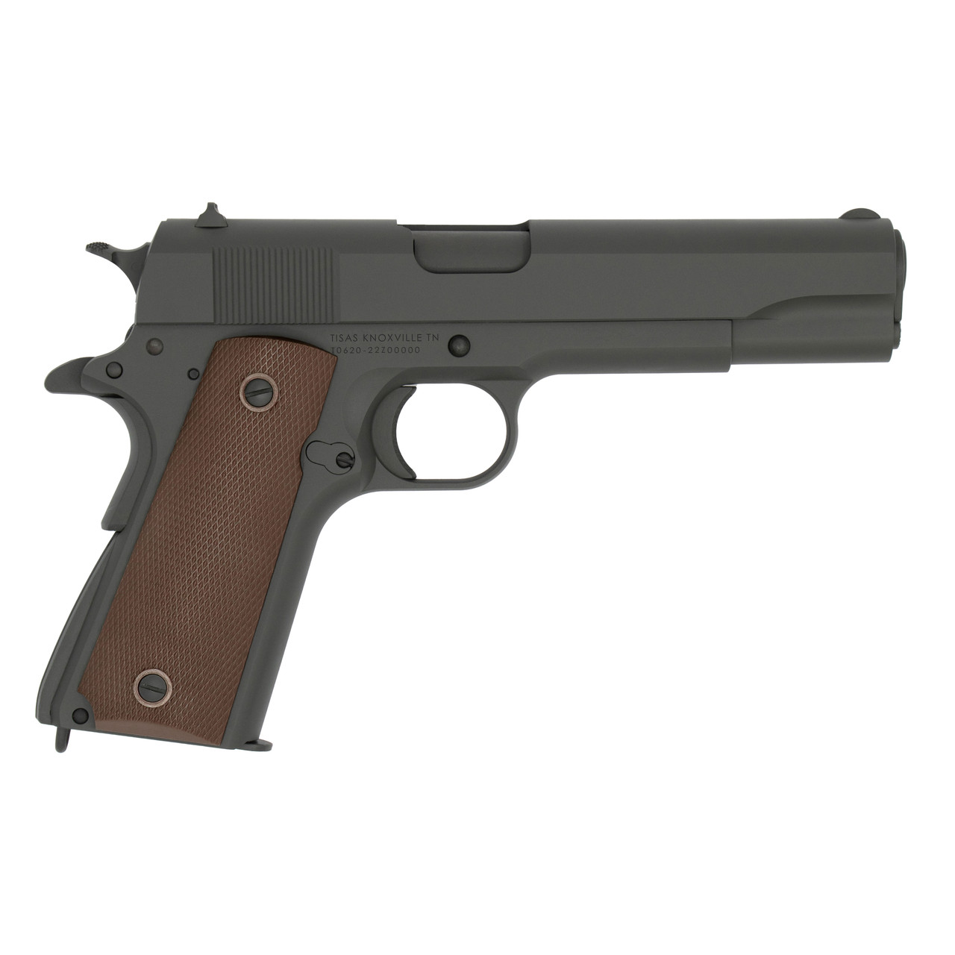
ELEVATION FIREFIGHTER’S ASSOCIATION TURKEY SHOOT
GUN BOARD
Tisas Duty 1911 Semi-Auto Pistol
$40 Per Card

Slide 12
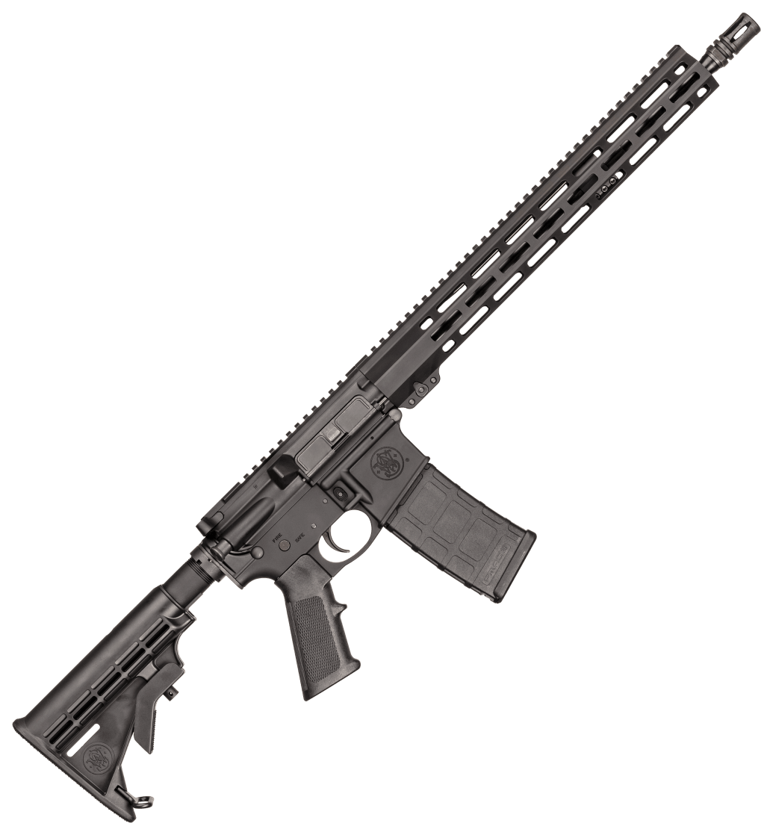
ELEVATION FIREFIGHTER’S ASSOCIATION TURKEY SHOOT
GUN BOARD
Smith & Wesson M&P Sport III
$50 Per Card

Slide 13
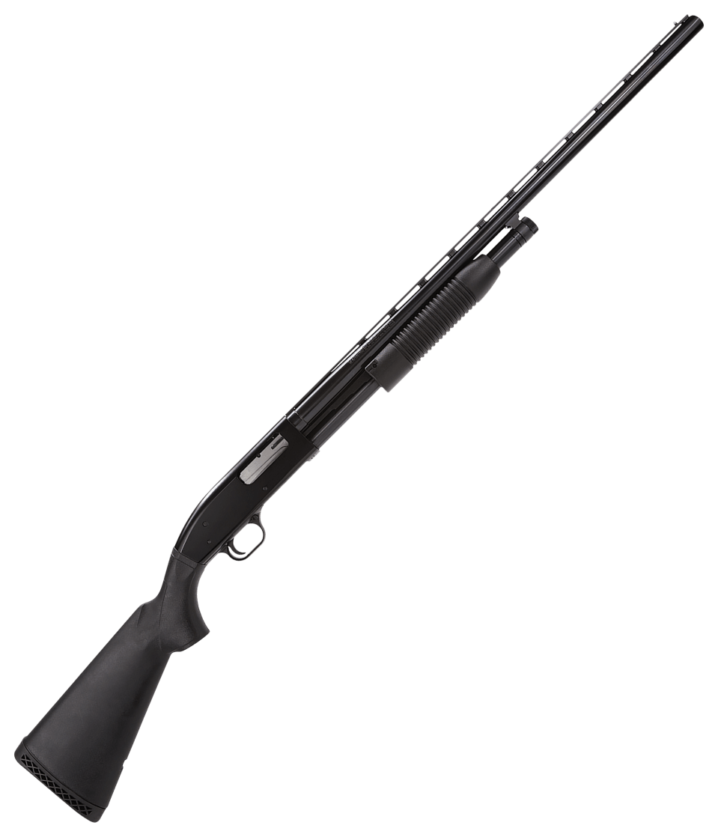
ELEVATION FIREFIGHTER’S ASSOCIATION TURKEY SHOOT
GUN BOARD
Mossberg Maverick 88 All Purpose Pump Shotgun
$25 Per Card

Slide 14
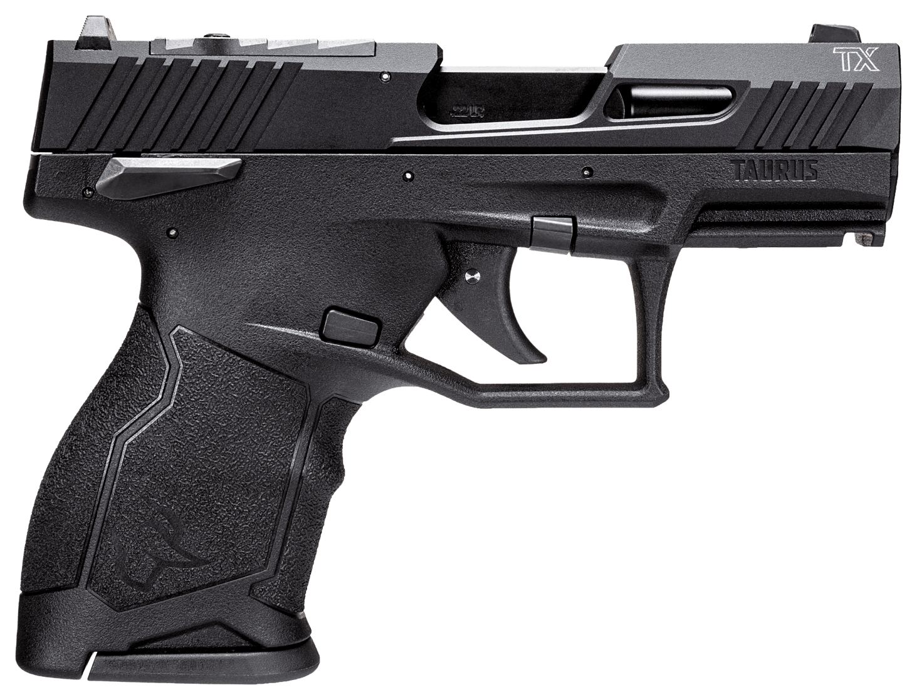
ELEVATION FIREFIGHTER’S ASSOCIATION TURKEY SHOOT
GUN BOARD
Taurus TX22 Compact Semi-Auto Rimfire Pistol
$25 Per Card

Slide 15
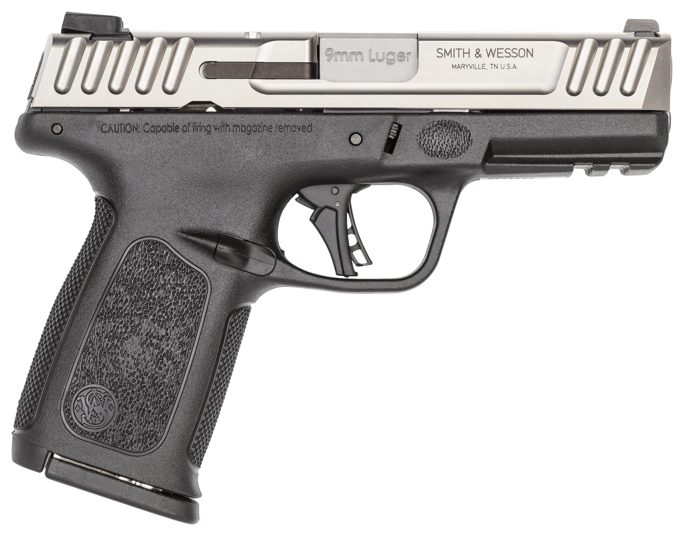
ELEVATION FIREFIGHTER’S ASSOCIATION TURKEY SHOOT
GUN BOARD
S&W SD9 Semi-Auto Pistol
$25 Per Card

Slide 16
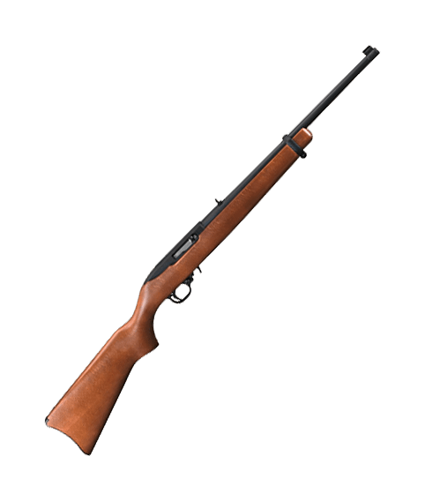
ELEVATION FIREFIGHTER’S ASSOCIATION TURKEY SHOOT
GUN BOARD
Ruger 10/22 Carbine Semi-Auto Rimfire Rifle
$30 Per Card

Slide 17
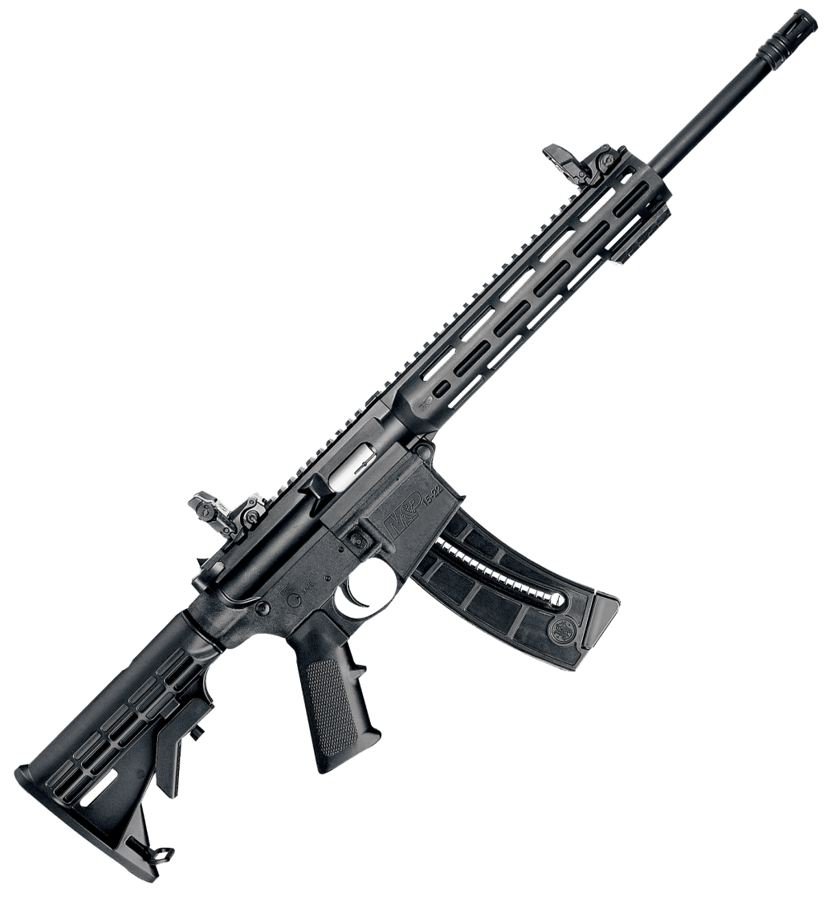
ELEVATION FIREFIGHTER’S ASSOCIATION TURKEY SHOOT
GUN BOARD
Smith & Wesson M&P Sport RIMFIRE RIFLE
$35 Per Card

